Slide 1
Journey of Take Action
Vyom Mahajan

Slide 2
Project Information
Name : Bell on Door
Location : My House
Date : 23rd May 2021
Good Practices related to Energy (utilisation of electricity) :
All the devices were switched off after using them
Devices were not overused and energy was utilised in the right amount

Slide 3
Main Challenge Area
The main challenge area I chose was conservation of electricity
I realised that sometimes devices were left switched on and I wanted to reduce the extra consumption of energy
My 3 main ideas were :
Alarm on the phone
Putting up posters on the walls
Bell on Door
I chose the 3rd option because I thought that it would best solve the problem

Slide 4
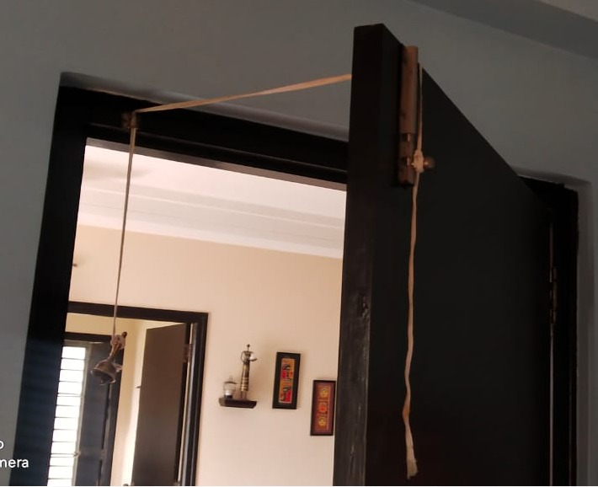
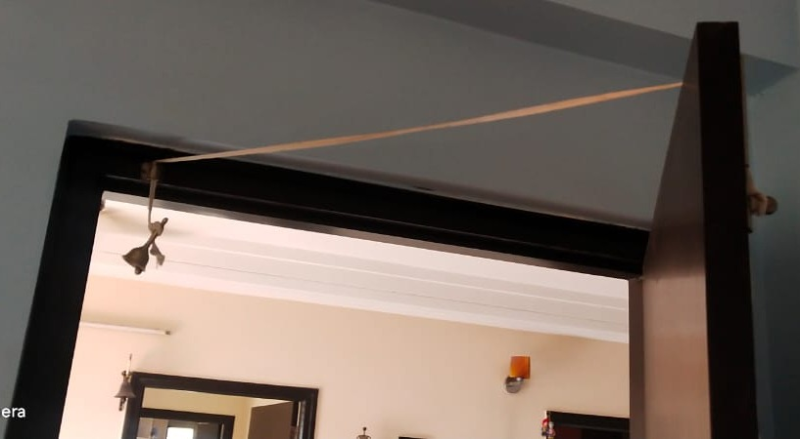
Prototype
Only 1 prototype was made. The video for it is on the next slide

Slide 5


Slide 6
Changes due to the project
Whenever you leave the room, this bell rings to remind you to switch off the devices
Even if the door is not closed, the bell is tied in such a way that whenever you go out of the room, you have to push the door and thus, it rings !!!
My parents and I have been impacted by this project
I have shared the video from the above slide with my family and friends so that they themselves can make this device as it is easy to make and use as well as economical

Slide 7

Audio recordings of my parents
Click the Symbol to listen to them

Slide 8
Feedback and Time to Reflect
My parents gave me a positive feedback for my prototype and so did my other family members.
The difficult part of this Take Action Journey for me was identifying the problem because my family and I were already aware of the amount of electricity consumed and we switched off the devices whenever not needed.
The best moments from this journey were the Ideating, Solve and Celebrate sessions because I had a lot of fun thinking of solutions, implementing the idea and celebrating the solution.

Slide 9
Thank you very much for this experience team lead by design. Thank you for giving me this opportunity to take action for the 2nd time !!!

